Slide 1
Validation & Global sensitivity analysis w/ LHS PRCC on Zhabotinsky 2000
11/12/2018

Slide 2
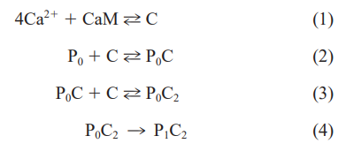
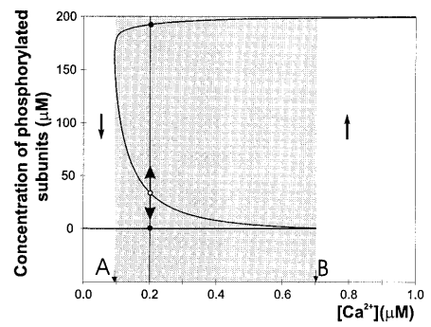
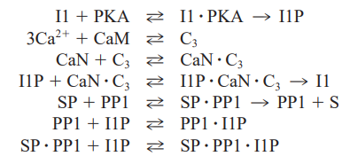
Zhabotinsky summary

Slide 3
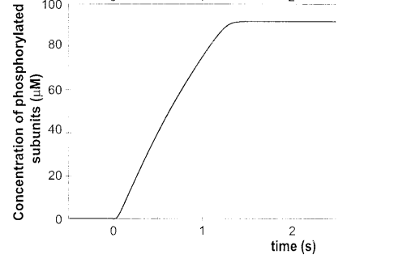
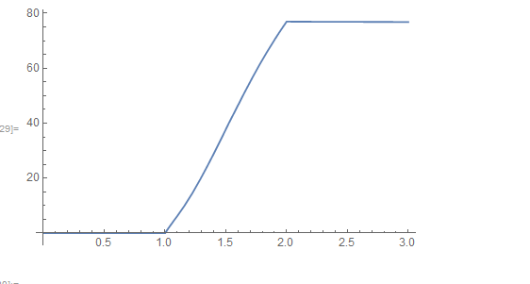

Paper vs My code: 100 Hz Ca2+
Ca2+ pulse peaks at 12uM
Same result w/ Ca2+ pulse peak of 1uM or 12uM

Slide 4
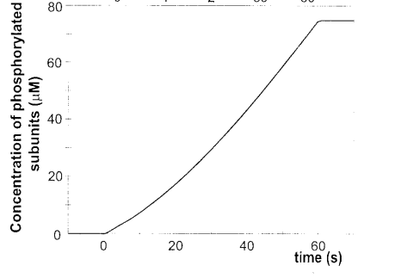
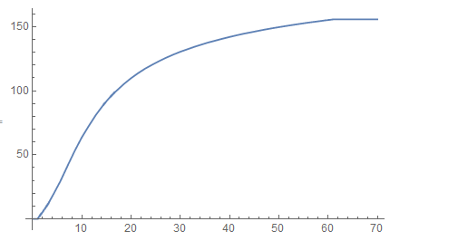

Paper vs My code: 10 Hz Ca2+
Messing w/ Ca2+ peak height isn’t working

Slide 5
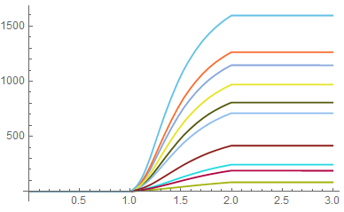
LHS output @ 100Hz, sweeping x10fold
Total phos.

Slide 6
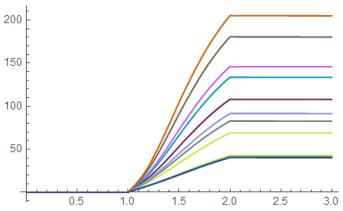
LHS output @ 100Hz, sweeping x2fold
Total phos.

Slide 7
PRCCs from 100Hz Ca2+ flux, WITH ‘ek’

Slide 8
PRCCs from 100Hz Ca2+ flux, W/O ‘ek’

